Slide 1
MCCP6020
Advanced English for Academic Purposes
Session 2
Reviewing and Critically Evaluating the Literature

Slide 2
Learning Outcomes:
By the end of this session, students should be able to:
organize, summarize and critique the literature
cite, reference, synthesize and paraphrase ideas from the literature; and
use appropriate rhetorical devices and linguistic features to express their stance in the literature review
explain key concepts and research findings in the literature

Slide 3
Warm-up Task
Find a partner. Share your experience about identifying relevant literature and reading academic research papers:
1. How do you usually find suitable and relevant research articles? Online search? Recommended by your supervisor?
2. In your research field, when do you need to review previous research? In which types of writing do you need to have a literature review?
3. Why do researchers need to review previous research?

Slide 4
Steps in Preparing to Write a Literature Review
1. Identify relevant literature
Identify key authors and renowned journals in your field using online search engines and the University Library website.
Check reference lists from articles, books and theses.
2. Read critically and make notes
Identify key themes in the literature.
Identify the recent developments in the field and note the limitations of the previous research studies.
Highlight, annotate the research papers and make notes.
Evaluate and analyse the literature and make comments.
Check out Endnote or other programs to see if it would be useful for you.
3. Prepare to write
Check the expected length and format of the literature review.
Categorise the literature using a systematic approach. Outline your literature review structure.
Delineate the scope of your literature review.

Slide 5
Task 1
General Purposes of Reviewing the Literature
Postgraduate researchers often have to demonstrate that their research is original and worthwhile. They should also prove that they are knowledgeable about the theories and the recent developments in their field. It is through your review of the literature that you can achieve the above.
Discuss the following questions in small groups:
What is the meaning of “originality” of research?
Originality of research means:
It addresses questions that have not been asked before in the literature.
It addresses questions that have been asked before, but have not been adequately answered in the literature.
It addresses old questions from a new theoretical perspective, method, or in the light of new information.
It addresses old questions in a new context.
It applies earlier research findings in a new way.

Slide 6
2. How can you show that your research is worthwhile in your thesis/journal article?
3. How can you demonstrate that you are knowledgeable about the theories and the recent developments in the field?
In most cases, there is a theoretical basis for the study. In the literature review section/chapter, you need to summarize ideas from the key specific studies to date and enlist the support from the research in your field by citing the work of other researchers in different sections of your thesis/journal article. For example, when discussing the findings of your study, you may need to make reference to the previous studies and see whether your research results confirm or contradict the findings of the previous studies.
You need to show that your research can make a significant or valuable contribution to knowledge. There should be NEW knowledge contributed by your research.
Examples of types of research contributions include theoretical/conceptual, empirical, methodological, pedagogical contributions.

Slide 7
What is a Good Review of the Literature?

Slide 8
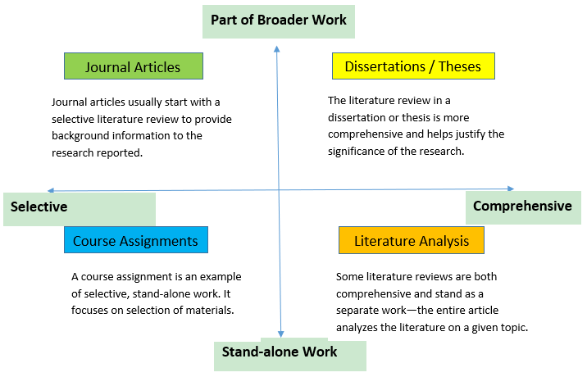
Functions and Moves of a Literature Review
Literature reviews can differ in structure, length, breadth and depth of content included. They can range from the selective (a narrow area of research) to the comprehensive (a larger amount or range of works). They can also exist as part of a larger work (i.e. in a journal article or thesis) or stand on their own.

Slide 9
Task 2
Read the following examples of literature reviews taken from two journal articles in Journal of Traditional Chinese Medicine and Journal of Marketing respectively. Discuss the questions below in small groups.
1. Can you identify the moves in the two literature reviews? Are the moves similar or different in the two literature reviews?

Slide 10
Example 1 (Journal of Traditional Chinese Medicine) | Move 1 – Background information about the topic (Alzheimer’s disease) Move 2 – Research focus (acupuncture) and summaries/syntheses of relevant previous studies Move 3 – Research gap (“The acupoints selection and combination play a critical role in impacting the therapeutic effects of acupuncture. However, determining the most effective acupoints selection and combination for AD still remains to be elucidated. Insufficient or improper acupoints selection and combination may contribute to a limited clinical therapeutic effects and the application of acupuncture for AD.”) Move 4 – Justification of the research methodology (data-mining) with reference to the previous studies Move 5 – Objectives of the current study
Example 2 (Journal of Marketing) | Move 1 – Main theme 1 (Impression Formation and Face Perception) and summaries/syntheses of relevant previous studies Move 2 – Main theme 2 (Beauty and Ugliness Premiums) and summaries/syntheses of relevant previous studies Move 3 – Main theme 3 (Online Profile Pictures) and summaries/syntheses of relevant previous studies Move 4 – Research gap (“Studies of the attractiveness effect have mostly used a small number of pictures in experimental settings rather than assessing real-world situations, leaving the robustness and generalizability of their findings open to question (Langlois et al. 2000). It is not clear from the literature whether social stereotypes based on attractiveness extend to the C2C e-commerce context. Researchers usually adopt a linear model or compare only two levels of attractiveness (i.e., attractive vs. less attractive), neglecting any potential nonlinear effect.”) Move 5 – State the importance of the current study

Slide 11
2. Compare the language use and citation style in the two literature reviews. Do you think they are similar or different?
Example 1 (Journal of Traditional Chinese Medicine) | Language use: No use of reporting verbs in the in-text citations. More technical terms are found (e.g. neurofibrillary tangles, senile plague, inhibiting tau protein hyperphosphorylation) The present tense and the present perfect tense are mainly used. The past tense is used to refer to the findings of previous studies. The active voice is predominantly used. Citation style: The numbered system is used.
Example 2 (Journal of Marketing) | Language use: Some use of reporting verbs in the in-text citations. Limited technical terms are used. The present tense and the present perfect tense are predominantly used. Some use of the passive voice when the focus is on actions, but the active voice is predominantly used. Citation style: The name-year system is used. The information-prominent approach is used more frequently.

Slide 12
Task 3
The structure of a literature review (LR) varies across disciplines, reflecting the conventions of each field. Some focus on chronological developments, while others emphasize themes or methods. Understanding these differences is key to writing an effective LR.
Now, analyze a literature review from your discipline. Examine its structure and how it organizes and transitions between ideas.
Work in a group of 2-3. Choose an example LR or Introduction with LR and read it. Discuss how the review of previous research is organized in paragraphs.
Highlight the topic of the paragraph or sentence(s) as well as words/phrases that show the logical development.
Discuss whether you notice any logical development problems? Can you give any suggestions for improvement?

Slide 13
Criteria | Possible Questions to Ask
Purpose of the article | What is the purpose of the article?
Arguments | Are the arguments clear? Are different viewpoints/perspectives on the issue given? Is there any bias (e.g. overgeneralizations, assumptions) in the arguments?
Use of evidence | What kinds of evidence is provided to substantiate the argument(s) (e.g. personal examples, data, empirical evidence)? How well does the evidence support the argument(s)? What is missing or omitted?
Methodology or approach for empirical studies | What approach was used for the research (e.g. quantitative or qualitative, case study?) Is this a cross-sectional study (i.e. subjects/people who differ on one key characteristic are studied at one specific point in time) or a longitudinal study (i.e. data are gathered for the same subjects/people repeatedly over a period of time/years)?
Sample | Is the sample size large enough? Is the sample representative?
Results | Are the results reliable? Can the results be generalized to the population?
Conclusion | What conclusions are drawn? Are these conclusions suggestive, definitive or justified? Does the research make an original contribution to the field? Why or why not?
Critically Evaluating the Literature
When writing the literature review, you are expected to critically evaluate the sources. The criteria and the questions below help you form the foundation for critical inquiry as you read the sources:

Slide 14
Task 4
Based on the above criteria, critically analyze a journal article you have recently read. If you were to cite this journal article in the literature review section in your thesis/manuscript, what critical comments about this source would you make? Make some notes in the space below. Share your ideas with a partner.

Slide 15


Based on the above criteria, critically analyze a journal article you have recently read. If you were to cite this journal article in the literature review section in your thesis/manuscript, what critical comments about this source would you make? Make some notes in the space below. Share your ideas with a partner.

Slide 16
Writing a Systematic Literature Review of Meta-analysis Review Paper
Writing a meta-analysis or systematic literature review (SLR) paper requires a structured approach to ensure rigor, transparency, and reproducibility. Below are detailed guidelines for preparing such a paper:
Clarity of Focus: Start with a clear, specific, and researchable question or hypothesis for the review.
Develop a Protocol: Set clear objectives, inclusion/exclusion criteria, identify databases (e.g. PubMEd, Scopus) and keywords, determine search strategy and how data will be collected.
Conduct a Comprehensive Literature Search: Search multiple databases to ensure comprehensive coverage. Document the databases, keywords, and filters used.
Filter Studies: Use the inclusion/exclusion criteria to filter studies. Use software for efficient screening.
Extract and Organize Data: Develop a standardized data extraction form to collect relevant information consistently.

Slide 17
Writing a Systematic Literature Review of Meta-analysis Review Paper
Assess Study Quality: Evaluate the quality and risk of bias in the included studies. Report the assessment explicitly and discuss its implications.
Conduct Data Synthesis:
  - For Systematic Reviews: Synthesize findings qualitatively by identifying patterns, themes, or gaps. Use thematic analysis or narrative synthesis.
  - For Meta-Analyses: Combine quantitative data using statistical methods. Calculate effect sizes.
  - Address heterogeneity in studies
Interpret and Discuss Findings: Highlight consistent patterns, significant results, and gaps. Discuss implications for practice, theory, and future research. Acknowledge limitations in your review process (e.g. publication bias, small sample sizes). Propose directions for future research or practical applications.
Include Visuals: Use tables, charts, and diagrams to summarize findings.
Reference Properly: Use reference management tools to cite sources correctly. Follow the required citation style.

Slide 18
Language Use in a Literature Review
Writing a literature review involves specific language features that help convey critical analysis, summarize existing research, and highlight gaps or contributions in the field. Here are some key features:
Reporting verbs (The choice of verbs reflects the writer’s stance on the source)
Evaluative language (Used to assess the quality, relevance, or impact of research)
Hedging (Used to avoid overgeneralizations and present claims cautiously)
Comparative language (Used to compare and contrast findings or perspectives)
Signposting language (Used to help the reader follow the structure and flow of the review)
Synthesis language (Used to integrate multiple sources and show relationships between them)

Slide 19
Task 5
Use of Reporting Verbs in Research Writing
When referring to the research of others in academic writing, we need to use reporting verbs. Appropriate use of reporting verbs can help the reader understand the relevance of the sources in your writing and can help you strengthen your argument. Reporting verbs can also show your attitude/stance towards the sources. Students always repeatedly use “states”, “points out” or “reports” when referring to the sources. In fact, there are many other reporting verbs:
Visit this website for more examples of reporting verbs: https://www.adelaide.edu.au/writingcentre/sites/default/files/docs/learningguide-verbsforreporting.pdf

Slide 20
Tentative reporting verbs | Neutral reporting verbs | Strong reporting verbs
Admit Consider Hypothesize Imply Postulate Propose Question Recommend Speculate Suggest | Comment Compare Define Describe Discuss Demonstrate Document Examine Explain Explore Identify Indicate Interpret Mention Note Observe Point out Report Regard Reveal Show Study State Take into consideration that | Acknowledge Advocate Affirm Argue Assume Challenge Concede Conclude Confirm Contend Deny Doubt Dispute Endorse Emphasize Establish Highlight Infer Maintain Oppose Object to Presume Refute Reject Stress Support the view that Substantiate

Slide 21
Reporting verbs can be used to convey the attitudes of the writer of the summary/literature review. What do you think about the attitude of the writer of the two sentences below?
Campbell (2010) presumes that the findings will be representative of the whole population… The authors speculate that people who scrap their old cars will immediately buy another new(er) car.
Notice also how the addition of an adverb can even more clearly reveal the stance of the writer. This is commonly used when making critical analysis of the sources.
The authors incorrectly assume that patients will always take the medicine that he been prescribed.

Slide 22
Practice: Replace “say” with each of the verbs listed and try to find out their implied meanings.
Dr. Mead says that COVID-19 could be airborne in addition to contact infection.
Words | Key | Implied meanings
1. Tells, states |  | a. You are not sure.
2. points out |  | b. He presents arguments for his views.
3. asserts, argues |  | c. He and you both think it is unquestionably true.
4. suggests |  | d. He is not sure.
5. claims, alleges |  | e. He knows something that you don’t.
6. implies |  | f. He does not say it directly but you read between the lines.
7. explains |  | g. You have mentioned some other view of his.
8. reveals, discloses |  | h. He says it when discussing something else and you accept it as a fact.
9. indicates |  | i. The idea is probably true but he doesn’t like it.
10. adds |  | j. More or less neutral.
11. mentions |  | k. It was a fact previously kept secret.
12. complains |  | l. He gives signs from which we can deduce he thinks this.

Slide 23
Answer key:
Words | Key | Implied meanings
1. Tells, states | j | a. You are not sure.
2. points out | c | b. He presents arguments for his views.
3. asserts, argues | b | c. He and you both think it is unquestionably true.
4. suggests | d | d. He is not sure.
5. claims, alleges | a | e. He knows something that you don’t.
6. implies | f | f. He does not say it directly but you read between the lines.
7. explains | e | g. You have mentioned some other view of his.
8. reveals, discloses | k | h. He says it when discussing something else and you accept it as a fact.
9. indicates | l | i. The idea is probably true but he doesn’t like it.
10. adds | g | j. More or less neutral.
11. mentions | h | k. It was a fact previously kept secret.
12. complains | i | l. He gives signs from which we can deduce he thinks this.

Slide 24
Extended Task: Find at least three well-written published research papers that are typical of papers in your field of study. Underline all the reporting verbs in the literature review section. Then, answer the following questions.
Answer the questions below:
1. What tense(s) is/are used for the reporting verbs? Why do you think the particular tense(s) is/are used?
2. Do you think the reporting verbs show the attitude of the writer of the summary/literature review? Can you give some examples?
This task was adapted from: Swales, J.M., & Feak, C.B. (2012). Academic writing for graduate students (3rd edition). The University of Michigan Press.

Slide 25
Task 6
Use of Evaluative Language in Literature Review Writing
A key role of your literature review is to show your critical analysis and evaluation of the literature. When reviewing the literature and taking notes, you can develop this critical evaluation by asking yourself questions such as:
What are the strengths and weaknesses/limitations of the different bodies of literature/studies you are reviewing?
What accounts for the different or similar findings in the previous studies? How can these be explained (e.g. theory or methodology adopted, the context of the studies, etc.)?
Which issues, gaps, ambiguities, unresolved problems, etc. in the literature do you wish to particularly address in your own research? Why?
What are the implications of your critical analysis and evaluation?
When writing up your literature review, you can use evaluative language to show your critical interpretation and evaluation.

Slide 27
1. Read the following short paragraphs. Underline all the evaluative language:
Hematopoietic lineage choice and differentiation require dynamic changes in gene expression, under tight regulation by lineage-specific transcription factors (TFs), whose interplay can promote or antagonize distinct fates. Our understanding of the TFs that are involved in myelopoeisis and the precise stages at which they function remains rudimentary. Our prior scRNA-Seq studies, coupled with colony assays, identified a novel mixed-lineage intermediate (MultiLin) state in which collapsing hematopoietic stem cell/progenitor (HSCP) gene expression is coupled with opening of early myeloid enhancers by PU.1 and Cebpa. We demonstrated that exit from the MulitLin state can occur via a metastable intermediate exhibiting simultaneous low-level expression of the antagonistic TFs Irf8 and Gfi1, and identified complex cross regulation between these factors and other TFs (Ets1, Per3, Klf4, Zeb2 and Irf5)7; however, the complete gene regulatory network (GRN) remains unknown. Basu, J., Olsson, A., Ferchen, K. Elizaveta, K., Chetal, K., Nicolas, E., Czyzewicz, P., Levchenko, D. Ge, L. Hua, X. Grimes, H., Salomonis, N., & Kappes, D. (2023). ThPOK is a critical multifaceted regulator of myeloid lineage development. Nat Immunol, 24, 1295–1307. https://doi.org/10.1038/s41590-023-01549-3

Slide 28
2. Read the literature review section of a journal article in your field. Identify instances of evaluative language and analyze their rhetorical purposes. Share your findings with the class.

Slide 29
Task 7
Choose a systematic literature review or meta-analysis paper from a reputable journal in your field.
Examine how the paper is organized.
Analyze the language features (e.g. reporting verbs, evaluative language, hedging, comparative language, signposting).
Reflect on how the structure and language of the paper contribute to its clarity and effectiveness.

Slide 30
Making Academic Attribution
Why do you need to cite sources in academic writing?
To demonstrate you are familiar with the work in your field
Incorporate other people’s work to justify your arguments and make your work more credible
Attribute the research space to the studies conducted by other researchers in order to show the originality of your research
Avoid plagiarism
What is plagiarism?
Plagiarism means making use of other peoples’ words or ideas without acknowledgement, copying word for word or only making slight changes when rewriting the ideas using your own words.
Plagiarism applies to all kinds of information and all types of sources including books, magazines, newspapers, lecturer’s notes, TV programmes, online videos, websites, students’ work.

Slide 31
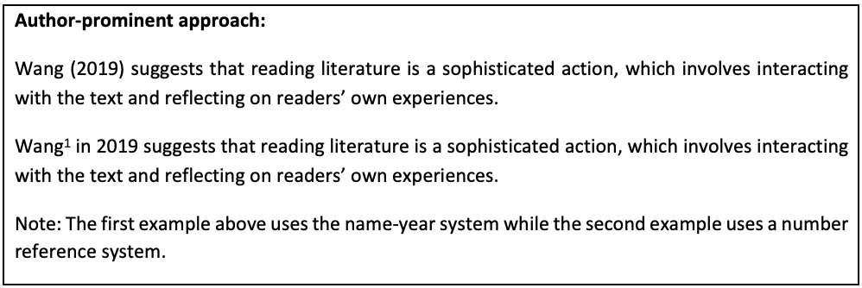
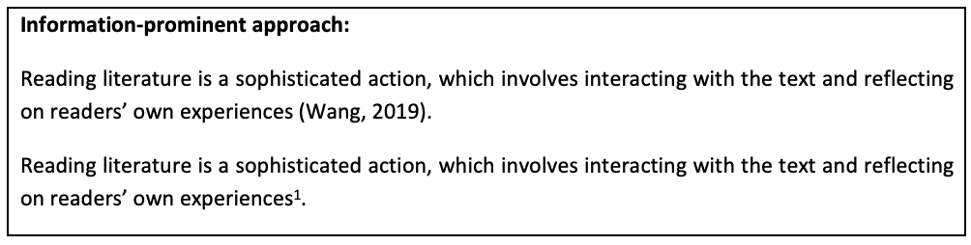
Task 8
Citation and Referencing skills (In-text citations, paraphrasing and synthesizing skills)
You can use the author-prominent approach or information-prominent approach in in-text citations. Compare the two approaches below:
1. Which in-text citation approach is more common in your field? Do you know why?

Slide 32
Sometimes direct quotations are used when the original wording is particularly useful or paraphrasing the ideas may change the meaning of the original text. The direct quotation should be indicated by double quotation marks, and the page number should be provided. For example:
2. Can you find any direct quotations in the sample journal articles/theses in your field? How are direct quotation cited in the text?
The survey of corporate senior marketing managers produced findings suggesting that “clients should be responsible for the strategic direction and planning, which are the foundation of integrated communications programs” (Low, 2000, p.36). The survey of corporate senior marketing managers produced findings suggesting that “clients should be responsible for the strategic direction and planning, which are the foundation of integrated communications programs”^{1, p36}
It is worth noting that direct quotations are often discouraged in the Sciences.

Slide 33
Paraphrasing is a more common in-text citation method than direct quotations. It means communicating the source’s ideas using your own words. There are several advantages: It shows that you have understood the ideas in the sources; you are able to select and skillfully integrate key definitions, theories, models, ideas of research findings into your own paper, using your own words.
If you want to use the information in the source but write in your own words, you could begin by identifying the important information in the sentences and the relationships between points. You then might think about the language to establish relationships:
What are the important points?
What are the important relationships between the points? (e.g. cause and effect, problem and solution, pros and cons, comparison and contrast)
What linking phrases and expressions that can connect the points? (e.g. because, therefore, as a result, due to, caused by, can be attributed to)
Next, you might consider possible synonyms for the source vocabulary and changing the part of speech (e.g. nouns to verbs) and sentence structure.

Slide 34
3. Read the following example of paraphrase. Identify the paraphrasing strategies adopted by the writer.
Original paragraph:
The use of a helmet is the key to reducing bicycling fatalities, which are due to head injuries 75% of the time. By cushioning the head upon impact, a helmet can reduce accidental injury by as much as 85%, saving the lives of hundreds of victims annually, half of whom are school children ("Bike Helmets: Unused Lifesavers", 1990).
Paraphrase:
Of the hundreds of bicycling deaths each year, three-fourths are caused by head injuries. Half of those killed are school-age children. One study concluded that wearing a bike helmet can reduce the risk of head injury by 85 percent. In an accident, a bike helmet absorbs the shock and cushions the head ("Bike Helmets: Unused Lifesavers", 1990).
Use of synonyms (e.g. school children → school-age children; caused by → due to; fatalities → deaths; 75% → three-fourths).
Changing the sentence structure (e.g. By cushioning the head upon impact, a helmet can reduce accidental injury by… → In an accident, a bike helmet absorbs the shock and cushions the head).
Changing the order of the information presented.

Slide 35
4. Choose one research article you have read recently and paraphrase a short section/paragraph of it. You may focus on the methods, results or implications. What tense(s) will you use in your paraphrase? Why? After you finished, show your paraphrase to a classmate. Then, show the original text to him/her. Get feedback.

Slide 36
When writing a literature review, you are expected to synthesize information from a number of sources that may overlap, slightly differ, or contradict each other. When working with multiple sources, you often need to infer and make explicit the relationships among them. This is called synthesizing skills. To do so, you need to identify the similarities and/or differences between the sources. Then, organize the ideas to ensure that you can logically present the information. To summarize, use the following steps to synthesize information from multiple sources:
Organize your sources and identify the similarities and differences between the sources
Outline the structure of the synthesis
Write paragraphs with topic sentences
Revise, edit and proofread the synthesis

Slide 37
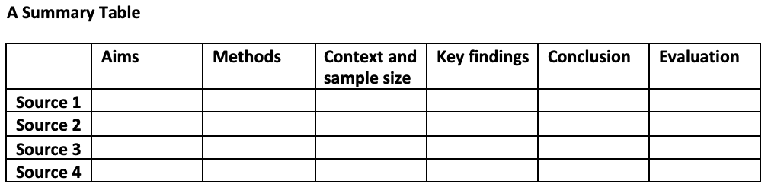
Step 1
You may use the following summary table or synthesis matrix to help you identify the relationships between the sources:
Each row in the table lists one source, and each column identifies a specific part of the source. You can decide which headings to include based on what is most relevant to the literature you are reading. The summary table gives you a quick overview of the key points of each source. This allows you to group sources by relevant similarities, as well as noticing important differences or contradictions in their findings.

Slide 38
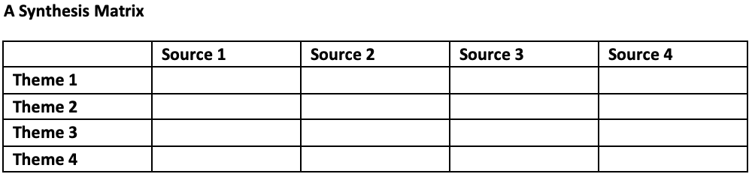
Step 1
If you plan to organize your literature review using a thematic approach, a synthesis matrix may help. Each column in the table lists one source. Each row is labelled with a specific concept, topic or theme that recurs across all or most of the sources. Then, for each source, you summarize the main points or arguments related to the theme. This allows you to identify the common points that connect the sources, and also the differences between the sources.

Slide 39
Step 2
The most commonly used approaches/frameworks for organizing ideas in a synthesis are: chronological, thematic, methodological and theoretical approaches. You need to decide which approach is more suitable for the literature you are dealing with.
Step 3
When writing a synthesis, each paragraph should discuss a few different sources, and you should be able to condense the overall point of the paragraph into one sentence which is called the topic sentence. The topic sentence signals what the whole paragraph is about; every sentence in the paragraph should be clearly related to it. For an effective synthesis, you can use topic sentences to link back to the previous paragraph or highlight a point of debate or critique. By using topic sentences, you can ensure that your paragraphs are coherent and clearly show the connections between the articles you are discussing.

Slide 40
Step 4
After writing the synthesis, you can use the following checklist to evaluate your synthesis:
√ Is there a clear and focused topic sentence outlining what the paragraph is about?
√ Is the paragraph organized around one single idea?
√ Has the synthesis discussed multiple sources?
√ Are the similarities and differences between the sources highlighted?
√ Is the synthesis written in your own words?
√ Is the synthesis directly relevant to your research question or topic?
√ Is there a logical transition between sentences and between paragraphs?
√ Are the sources cited correctly using the correct referencing style and conventions?

Slide 41
6. Choose three research articles you have read recently and identify the common points between them. Write a synthesis (no more than 80 words) of the information from the three sources. You may focus on the methods, results or implications. After you finished, show your synthesis to a classmate. Use the checklist above (in step 4) to evaluate the synthesis.

Slide 42
Independent Learning: Using Corpora to Improve Academic Writing
BNC Web Corpus
Video 4: Search for One Word (indicate); Sort and Frequency Breakdown Functions (~8 minutes)
  https://youtu.be/esL5EVjkHVw
Video 5: Search for Phrases (the NOUN that) (~7 minutes)
  https://youtu.be/YeLGzHmJ7N0
AntConc
Video 5: Search for Collocations in AntConc (~6 minutes)
  https://youtu.be/rNdmJOF25_k
Continue to use your personal corpora to do linguistic search!

